Slide 1

CS299 lab Project TA Allocation Portal

Slide 2
Introduction
TA Allocation Portal can be used to assign TAs to different courses. It has also the feature of editing the previous allocation and reassigning new TAs to new courses.

Slide 3
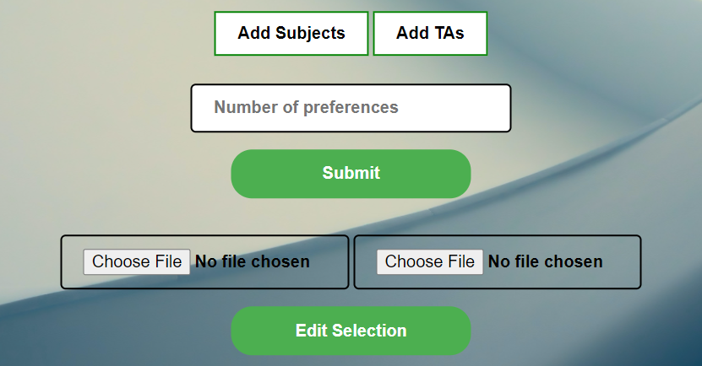
Features
We can directly import CSV file of Subjects and TAs.
Once the allocation has been done, a mail will be sent to each allocated TA with CSV file of their allocation.
We can also edit previous allocations.

Slide 4



Tech stack used
PHP for the backend of the website.
CSS, JavaScript, JQuery for the frontend of the website.
SQL for the managing the database.
PHPMailer (a library) for sending mails.

Slide 5
Let us see the demo of the website

